Slide 1
Internship at CloudMoyo Summer 2019
Manvir Singh

Slide 2

Company
CloudMoyo is the partner of choice for solutions at the intersection of cloud and AI.
CloudMoyo works with rail and transportation companies.
Headquartered in Bellevue, WA, with an innovation center in Pune, India

Slide 3

My Role as an Intern
My Role was a mixture of both software engineering and program management
I worked alongside the company V.P Sanjay Rajashekar.
Conducted research on the topic, deeper analysis into the technology
Notes:
Change to bullet points

Slide 4
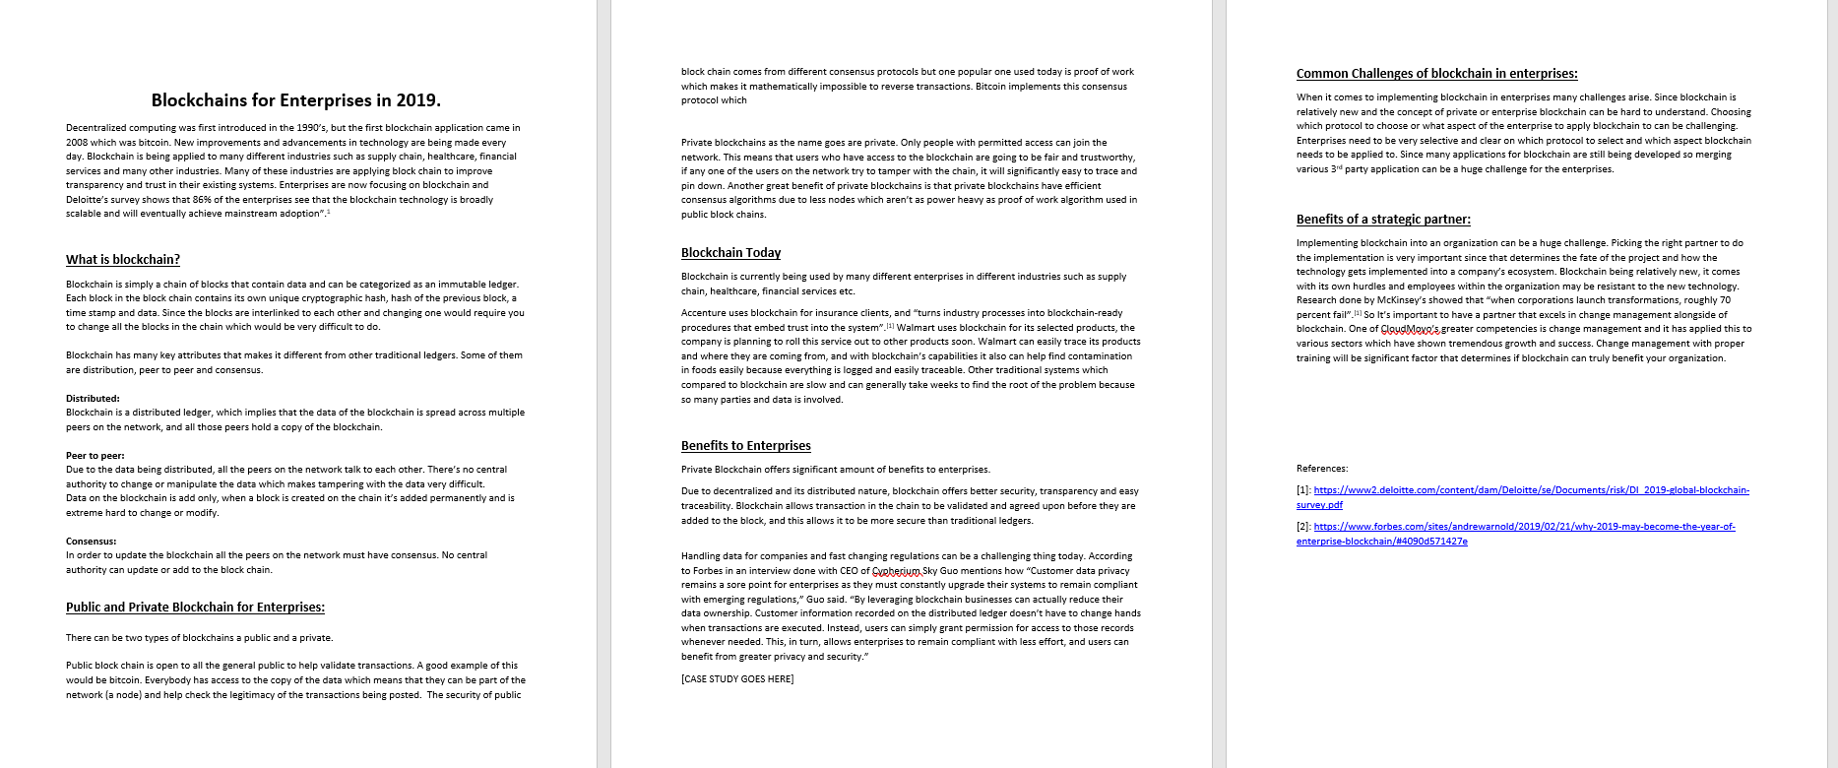

Blockchain initiative
Blockchain:
Learned the fundamentals
Blockchain at enterprise level
Benefits of blockchain to CloudMoyo
Internal report, blog and a prototype

Slide 5
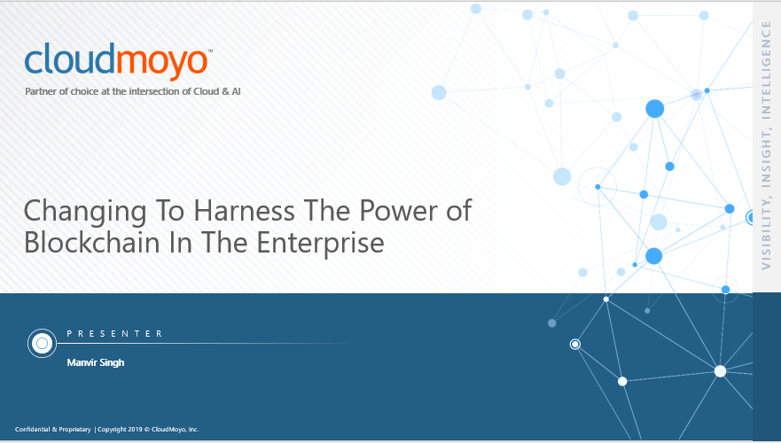
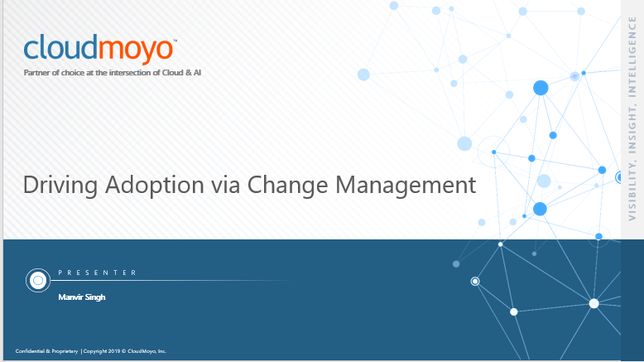
Change Management
Fundamentals of change management
Recognized the problem at cloudmoyo
Developed an offering cloudmoyo can take to market.

Slide 6
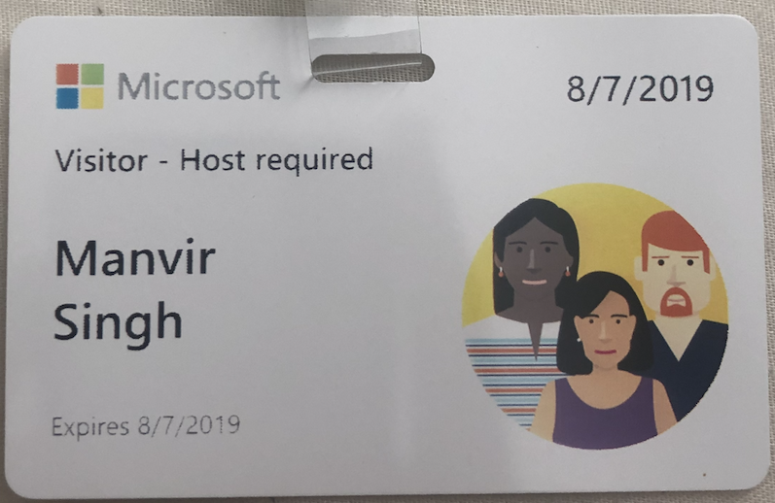
Other projects
PowerApps:
Researched the service
Benefits to CloudMoyo
Parthnership with Microsoft
Data analysis:
Learned python and M.L algorithms

Slide 7
Key learnings
Importance of blockchain & CM
Developed key offerings & new initiatives
Exposed myself to new fields
Working with international teams
“7/10 projects fail if correct change management is not implemented in place”

Slide 8
Special Thanks to Professor Mark Kochanski & CloudMoyo
Any questions?

Slide 9
